Slide 1
HS 229: Environmental Economics
Mrinal Kanti Dutta (mkdutta@iitg.ac.in)
Dept. of Humanities and Social Sciences, IIT Guwahati

Slide 2
Course Outline

Slide 3
1. The Economy and the Environment
Economy-environment interaction
The first and second law of thermodynamics
Environmental degradation as market failure
Pigovian tax, property rights and transactions costs

Slide 4
2. Economics of Natural Resources
Resource Taxonomy
Renewable and non-renewable resources
Common property resources
Open access, the tragedy of commons

Slide 5
3. Valuation Techniques
Contingent valuation, hedonic pricing, travel cost method
Environmental impact assessment
Classification of environment and resource flows, use and non-use value

Slide 6
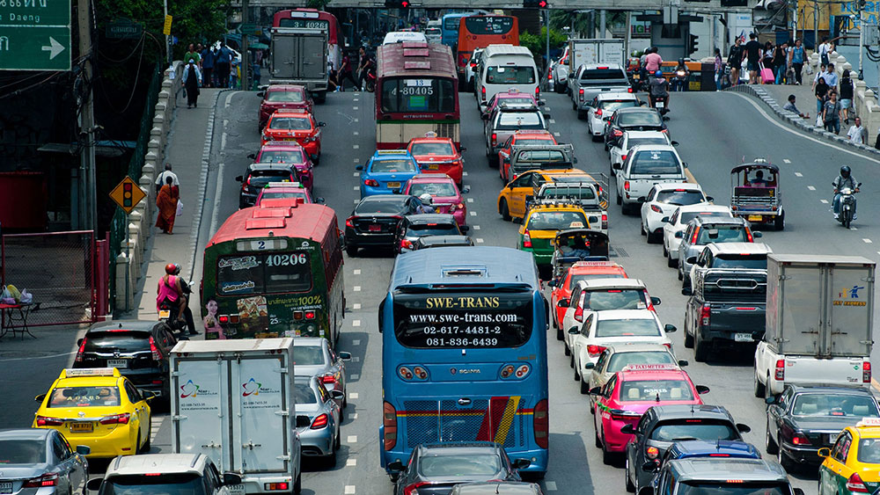

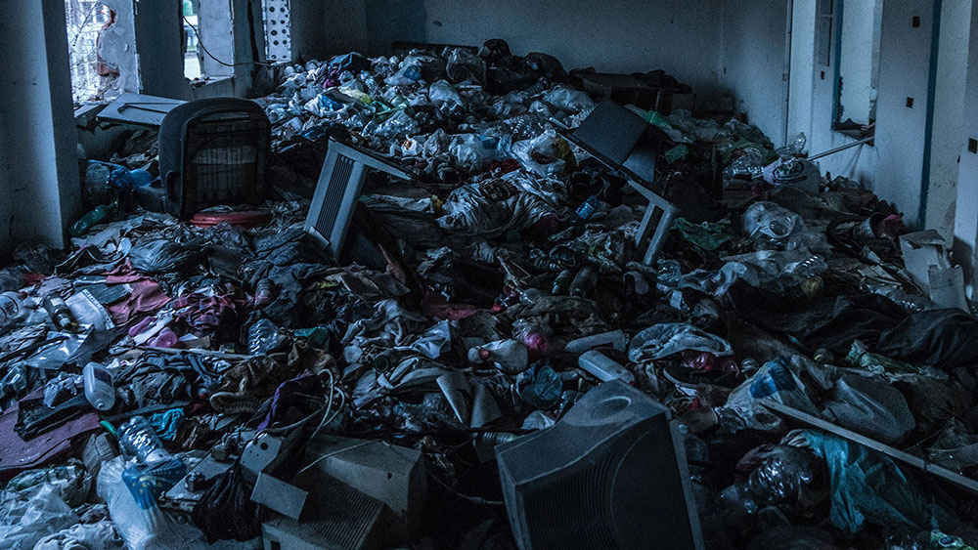

4. Pollution Control
Pollution Prevention, control and abatement
Command and control instruments and market based instruments– taxes vs. tradeable permits
Overview of different acts/laws for pollution control in India

Slide 7
5. Environment and Development
Poverty and environment
Sustainable development- concepts and indicators
Environmentally adjusted GDP, System of Integrated Environmental and Economic Accounting (SEEA)
Environment-development trade off, environmental Kuznet curve

Slide 8
Texts/References
1. N. Hanley, J. F. Shogren and B. White, An Introduction to Environmental Economics, Oxford University Press, 2001
2. C. Kolstad, Environmental Economics, Oxford University Press, 2000
3. N. Hanley, J. F. Shogren and B. White, Environmental Economics: In Theory & Practice, 2nd Revised edition, Palgrave MacMillan, 2006

Slide 9
Texts/References
4. T. Tietenberg, Environmental and Natural Resource Economics, Pearson Education, 2004
5. U. Sankar (ed.), Environmental Economics (Readers in Economics), Oxford University Press, 2001

Slide 10
About the Class
Classes will be held as per time table (M/T (12-12.55 pm) and F (11.00-11.55 am)
Attendance in class is important
Interaction highly welcome

Slide 11
About evaluation
Evaluation will be done as mandated by the Academic Section
Mid-semester and end-semester examinations are mandatory
We shall target for quiz/zes for continuous evaluation
Weightage of each component for evaluation will be as follows:
Mid-sem: 30%, End sem: 50%, Quiz: 20%
Any change in the evaluation process will be intimated well in advance

Slide 12
THANK YOU!

